Slide 1
Sitraffic smartTL Connect
Intelligent Traffic Systems

Slide 2
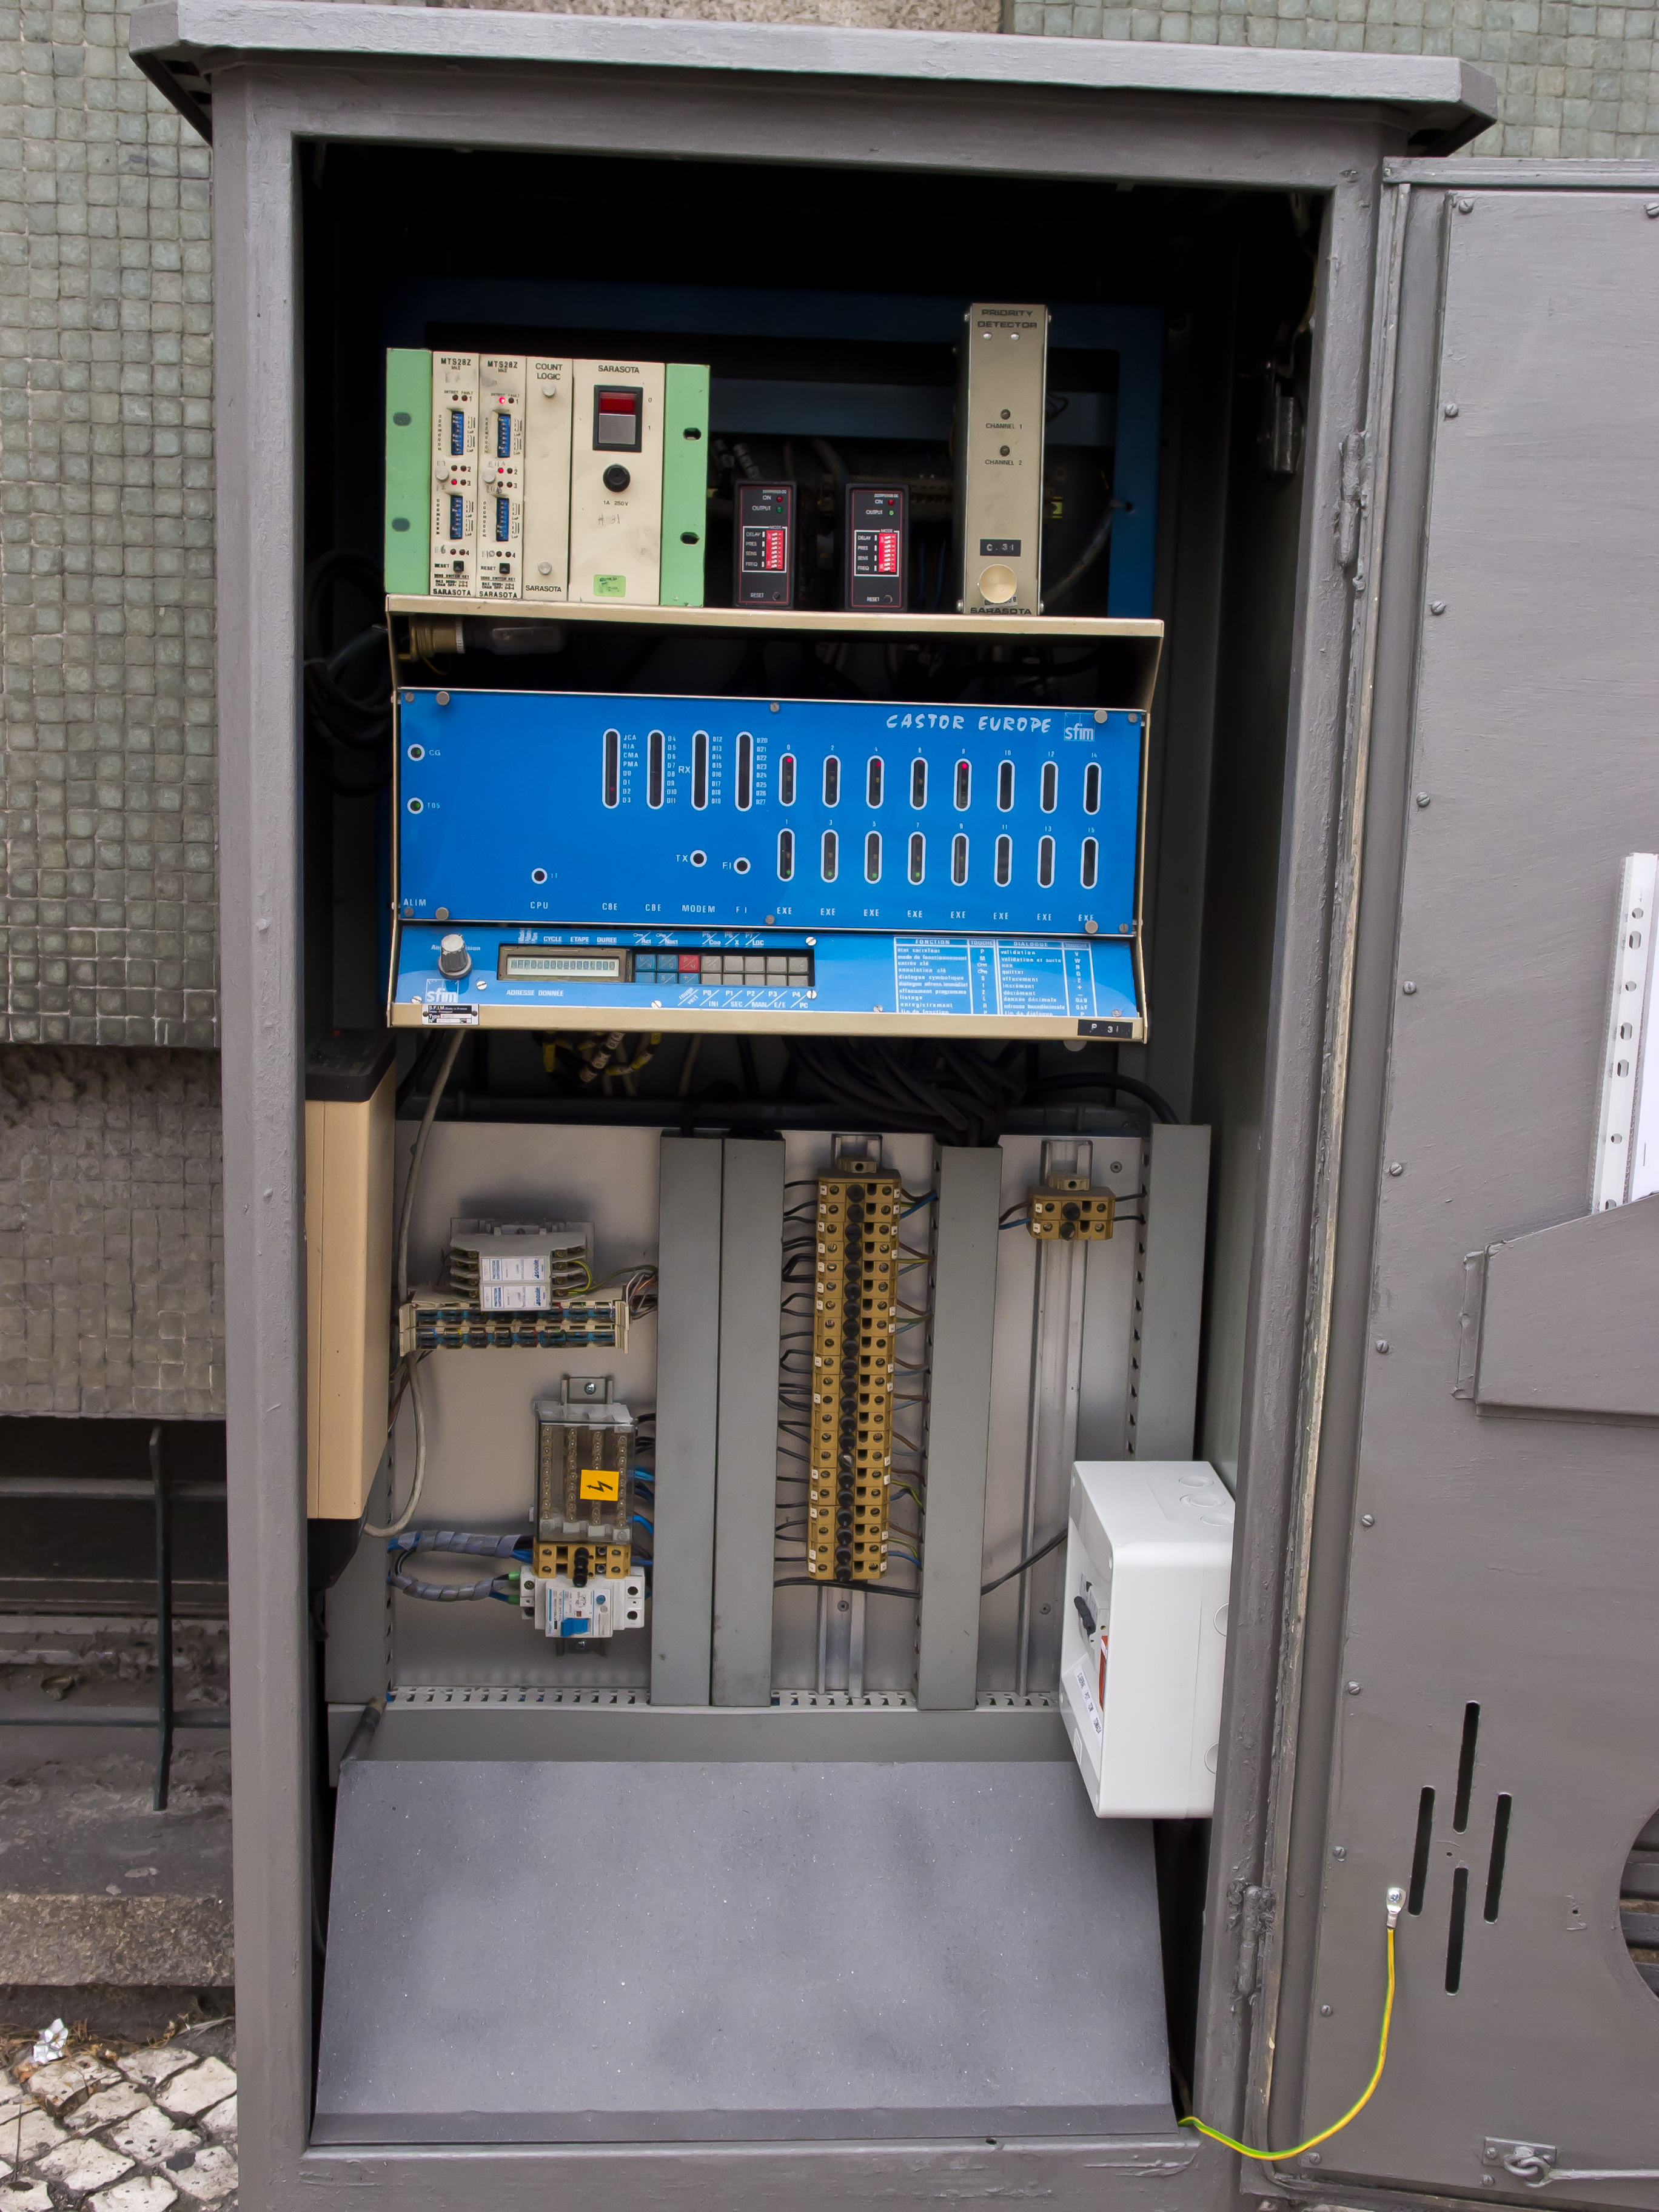
Digitalization in Mobility
Existing Infrastructure
Contractual obligation: automatic detection plan
> 20 year old controller
½ controllers connected to Traffic Management System (Gertrude)
Optical fiber and Copper Networks (Majority)
Obsolete equipments
Lack of information (schematics, drawings, no remote connection in more than ½ of the intersections)

Slide 3

SmartTL Connect| Our Vision
Development of an independent, adaptable and unobtrusive solution that aims to integrate 3rd party controllers into smartGuard without the need for any changes to the hardware already in place.
We will not provide the same scope of functionality that Siemens controllers have (integration, not competition).
Focus on simplicity and flexibility.

Slide 4
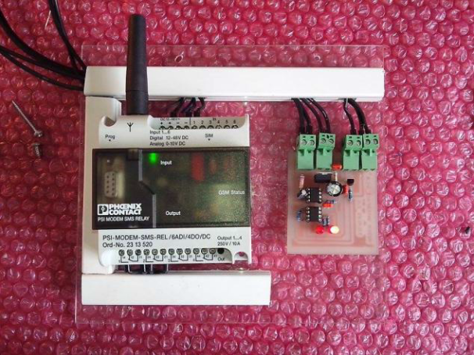
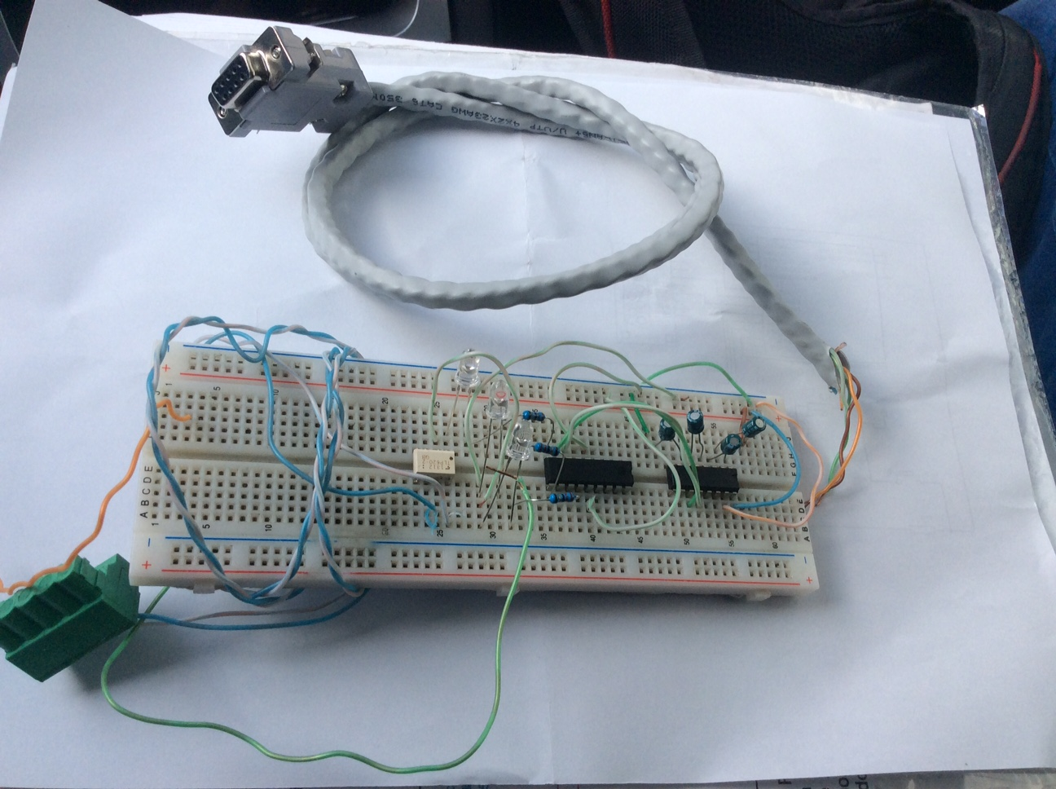
SmartTL Connect| Developments Made
Automatic Detection Plan – 1st phase
Automatic Detection Plan – 2nd phase
Connected to Castor controllers
Now working sending SMS to customer and field teams
Problem: Dependency on Modem
Built in serial RS 232 protocol
Simple interface with PC
Achievements: compatible with any modem
Next Steps: Integration with smartGuard

Slide 5
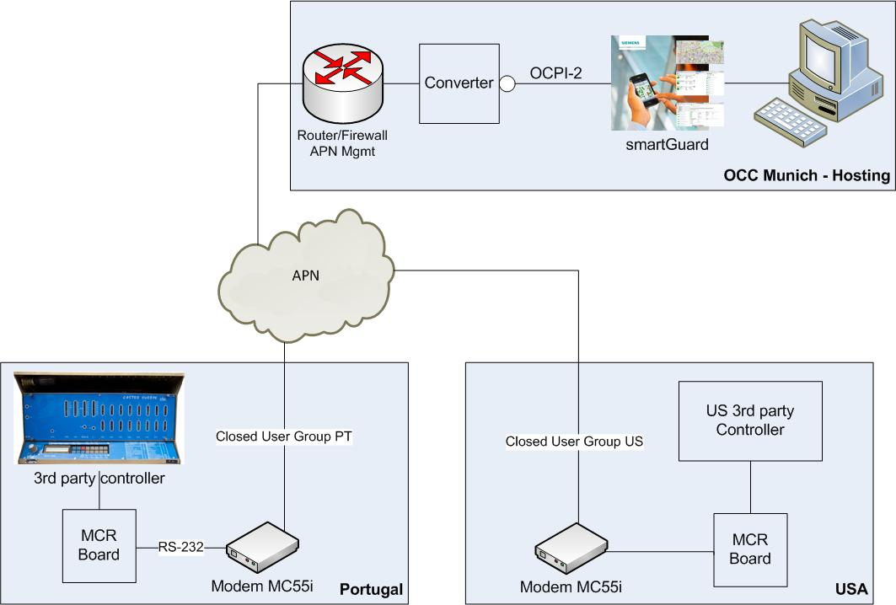
SmartTL Connect| Global Architecture

Slide 6

Converter | Software Architecture
OCPI-2 Wrapper
① Includes all interaction with SOAP protocols presented by the OCPI interface from SmartGuard
② Main module, including:
Main logic to convert elementary status info into SmartGuard notation for equivalent status
Configuration functions
③ Presents a higher level feature set for communicating with the Pantera Negra boards on the field
④ Communication with Pantera Negra boards via RS-232/modem
⑤ Communication with Pantera Negra boards via IP Protocol
①
Core – 3PC
②
COMM Wrapper
③
RS-232
IP
④
⑤

Slide 7




Communications | Evolution Planned
Initial stage, already implemented and being used.
Flexibility regarding modem solution.
Current status, under development.
Great flexibility and optimization of communications.

Slide 8
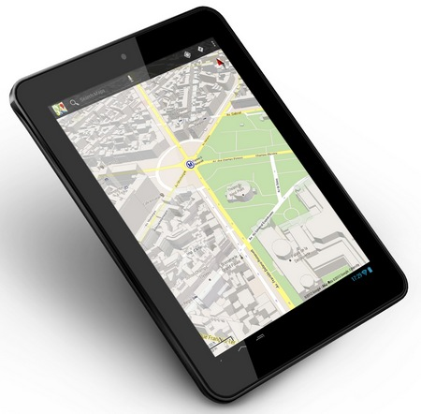

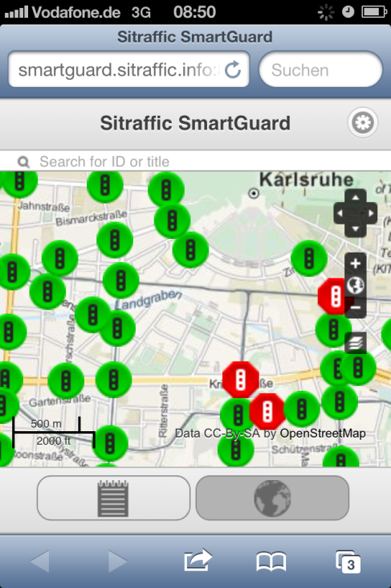
Evolution steps | Progress
Electronic developments
Tests made on the field with implemented solution
Approval and Support from the HQ
Information about OCPI-2 already shared
Software development made in Portugal
Test environment for solution
Connect 3rd party Controllers to smartGuard
Present on Intertraffic 2016
Applicable to other countries

